Slide 1
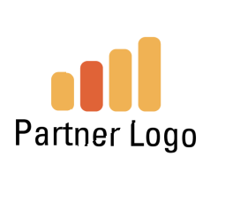
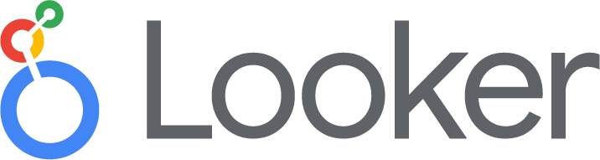
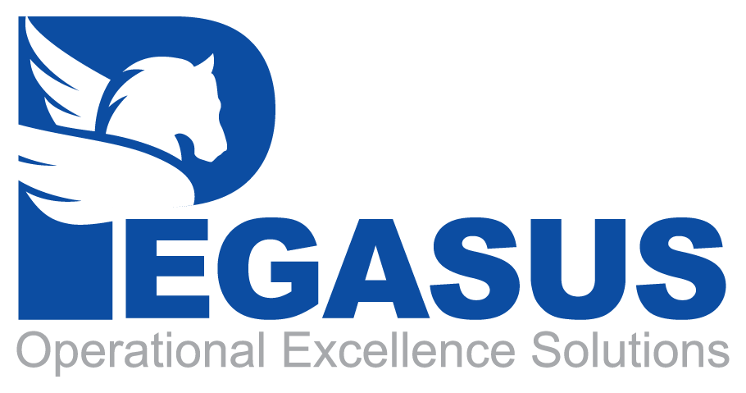
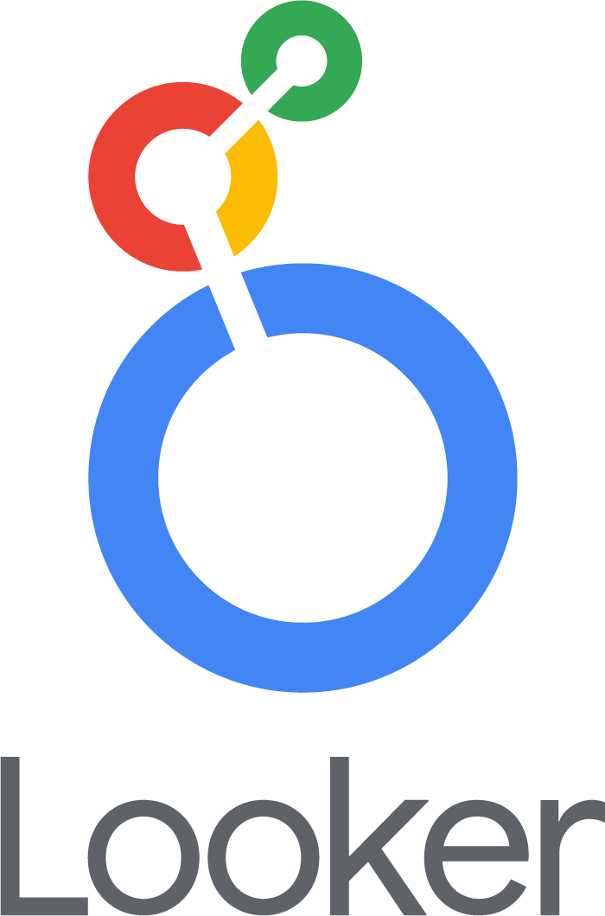
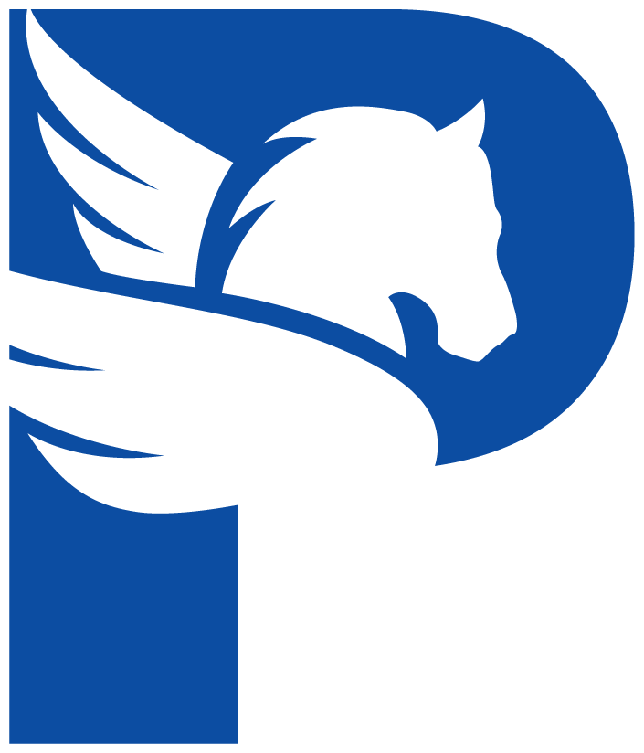
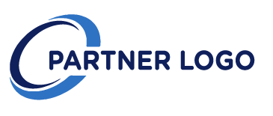
Partner Lockups
How to present with a partner.
Do
When pairing a lockup with a partner logo, use the version that matches the orientation of the partner logo. For example, horizontal with horizontal or vertical with vertical.
Don’t
Don’t pair lockups with different orientations together.

Slide 2
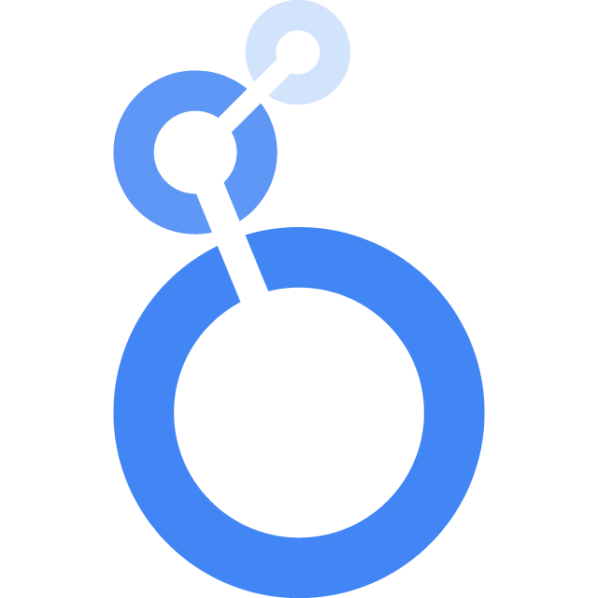
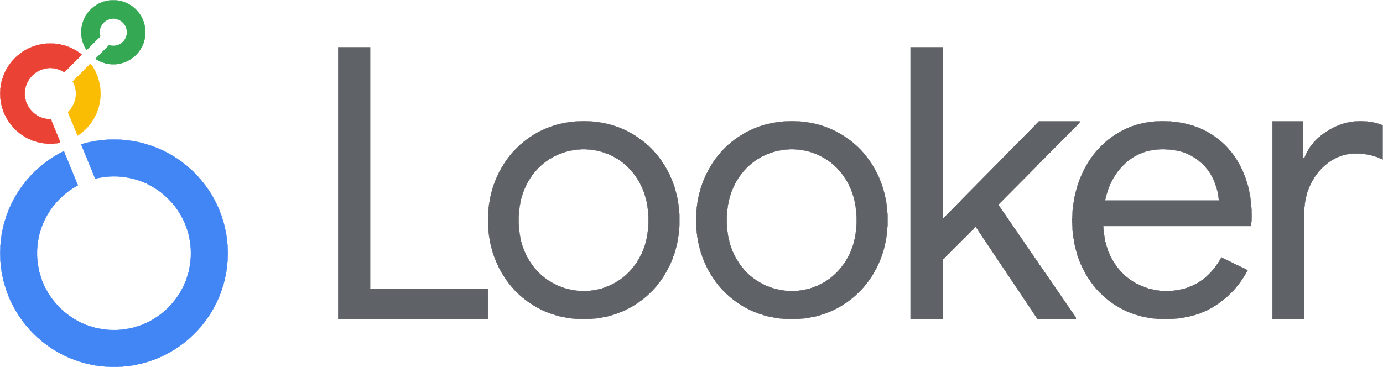
Logo
Badge

Slide 3
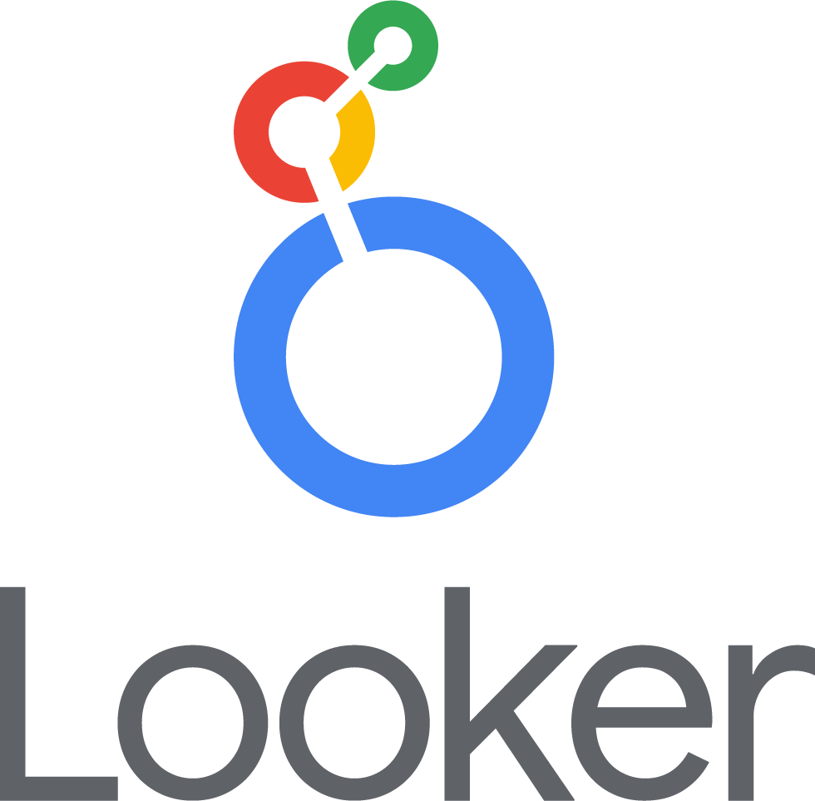
Logo
Horizontal Logo
Vertical Logo (large calipers)
Vertical Logo

Slide 4
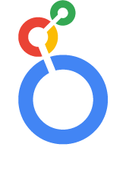
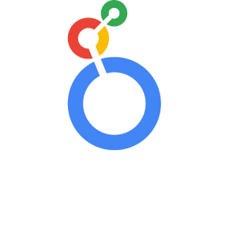
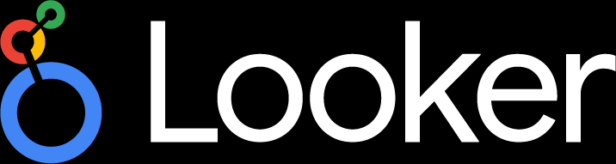
Logo

Slide 5
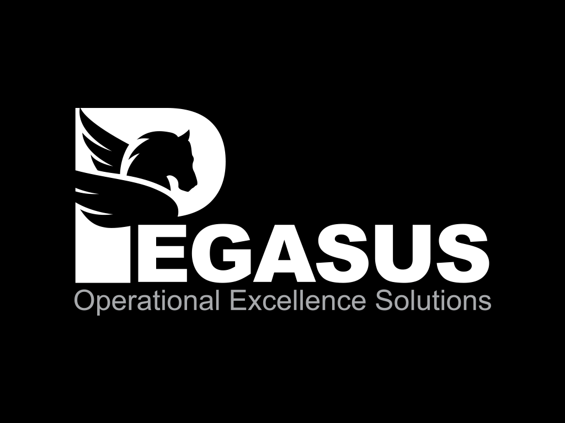

Logo

Slide 6
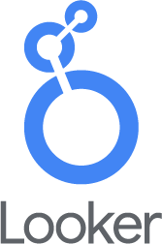
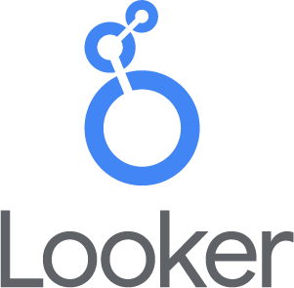
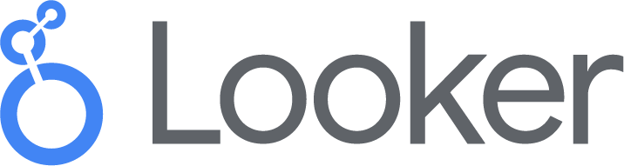
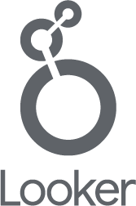
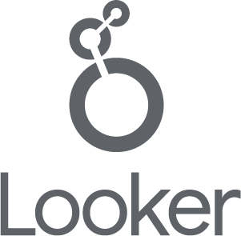
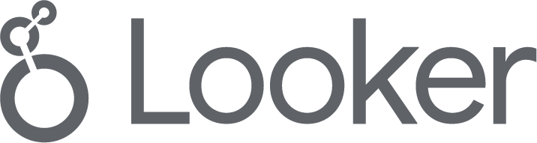
Logo
Full Color
Blue
Color
Single Color
* Calipers should be in flat colors when used in a lockup with the Looker word mark. Calipers should be shaded when used as a standalone graphic. (See next slide).

Slide 7
Fonts
Google Sans
Roboto
Aa Bb Cc Dd Ee Ff Gg Hh Ii Jj Kk Ll Mn Nn Oo Pp Qq Rr Ss Tt Uu Vv Ww Xx Yy Zz
Aa Bb Cc Dd Ee Ff Gg Hh Ii Jj Kk Ll Mn Nn Oo Pp Qq Rr Ss Tt Uu Vv Ww Xx Yy Zz
Google Sans is a proprietary typeface created expressly for Google. It has round, geometric letterforms that mirror the Google logo and lowercase letters that are approachable and playful. We use it to differentiate our products and communications: When you see Google Sans, you know it’s from Google.
Roboto is another primary typeface. It’s slightly wide and round, giving it great clarity and an optimistic feel. Since it’s an open-source typeface used around the world, it’s not as ownable as Google Sans. We use Roboto for body copy, third-party content, and utility features such as user input fields.
To help deliver a unified user experience for users across all touch points, use only Google Sans and Roboto in all Looker communications. For downloads, usages, expanded font library and more, visit the Typography Overview in the Brand Guidelines

